Slide 1

Smartphone 4: Pedometer
Project by: GROUP 4

Slide 2
Presentation by:
Thomas Carbonaro (Tcarbona@Stevens.edu)
Haijun Huang()
Yupei Liang()

Slide 3
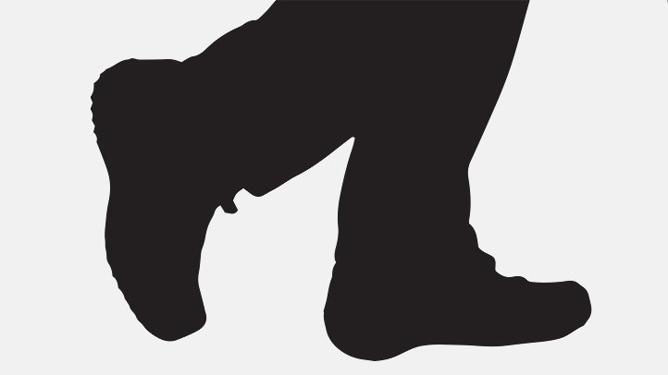
Agenda
Overview and Introduction
Code Changes/Future Work
Team Input
Demonstration
Questions

Slide 4
Overview and Introduction
Our motives and timeline

Slide 5
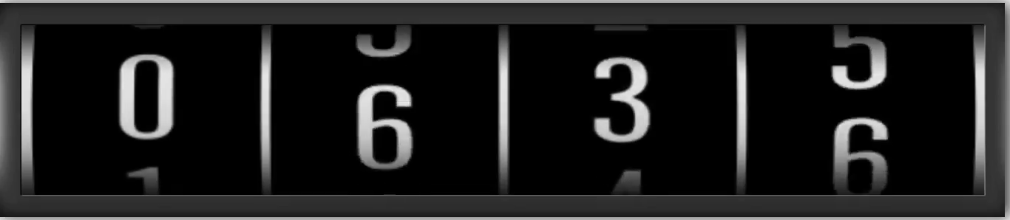
What is a pedometer?
A pedometer is a device, usually portable and electronic or electromechanical, that counts each step a person takes by detecting the motion of the person's hands or hips.
Health Benefits of walking including:
increased cardiovascular and pulmonary (heart and lung) fitness
reduced risk of heart disease and stroke
improved management of conditions such as hypertension (high blood pressure), high cholesterol, joint and muscular pain or stiffness, and diabetes
stronger bones and improved balance
reduced body fat

Slide 6
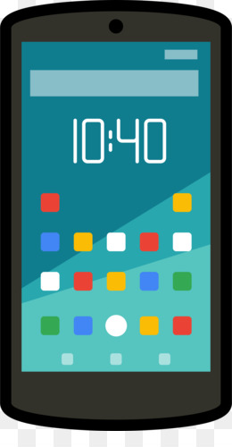
Timeline:
Chose the smartphone as our preference of project topic
Discussed as group that we would choose the pedometer project
Divided tasks among ourselves
Started to bring together our work
Debugging phase
Demonstration practice

Slide 7
Code Progress/ Future Work
The process of getting to our final product with thoughts on future enhancement

Slide 8

We created and coded the pedometer application using a program called Android Studio
Our highest priority was to first make sure that we were able to do the main functionality of tracking a step
For this, we needed to calibrate the accelerometer and set the proper threshold for the app to make a count for the specific motion of a step
Once the step is registered, it will show on the display of the app as the counter increases

Slide 9
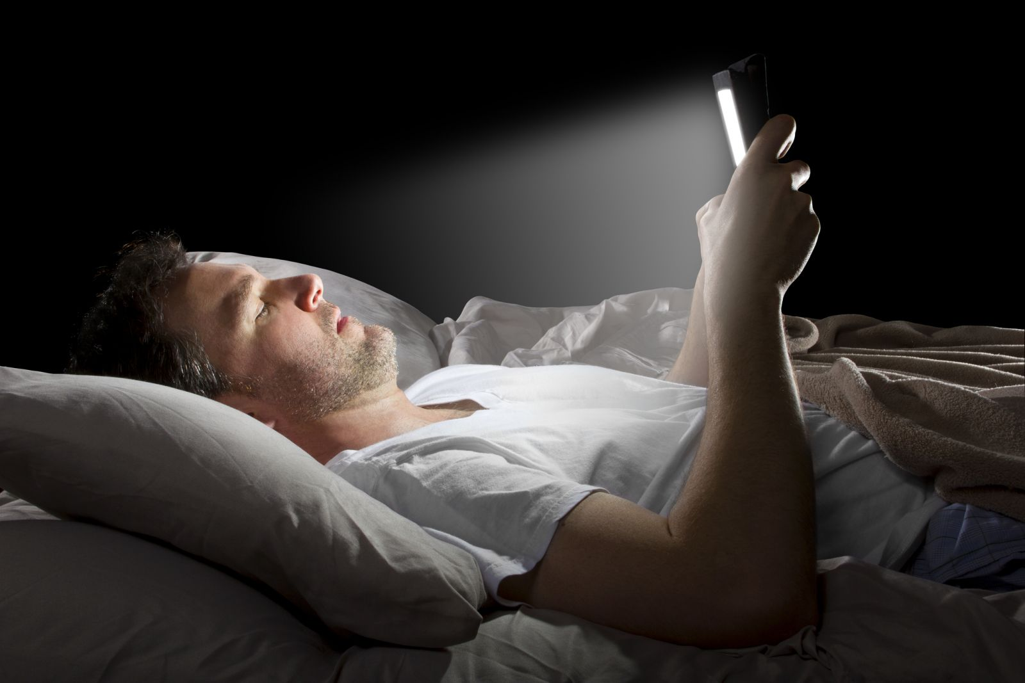

After brainstorming ideas and taking consideration of the class’s feedback, we decided to use the smartphone’s light sensor as our second sensor used
The light sensor is used in a function that controls the brightness of the smartphone’s screen while in differently lit environments
The reading from the light sensor is also displayed on screen

Slide 10
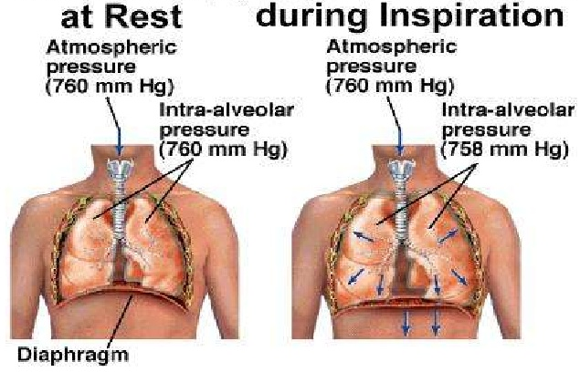
The last sensor included took us some time because we were unsure of which to utilize
We ultimately chose using the pressure sensor.
The reading from this sensor displays on the smartphone screens while in the application
This is particularly useful for hiking at higher altitude elevations such as mountains (higher altitude → less air pressure → more difficult time breathing)

Slide 11
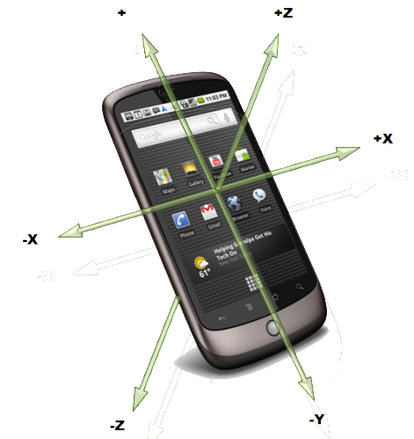
Future Work
A potential idea we had that we dropped due to time constraints was utilizing the gravity sensor. A nice feature would have been the application interface change between landscape and portrait modes while the phone rotates
A second potential idea is also the possibility of logging the daily steps in a dated database with access to this log through the app

Slide 12
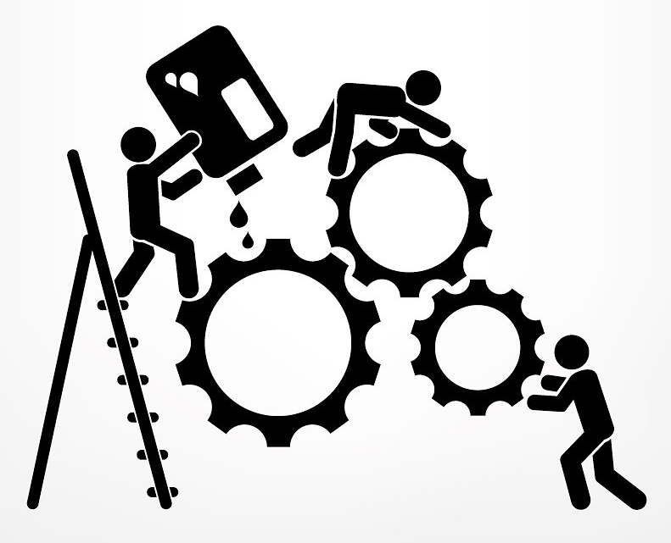
Responsibilities
Breakdown of how we split our tasks

Slide 13

We collectively worked together when it came to deciding and thinking of which ideas and functions were to be used but we also did have individual tasks
Individual responsibilities were broken down as the following:
Thomas – User interface, documentation processes
Haijun –
Yupei –

Slide 14
Demonstration
We will now demonstrate the projects functions and features

Slide 15

Questions?

